Slide 1
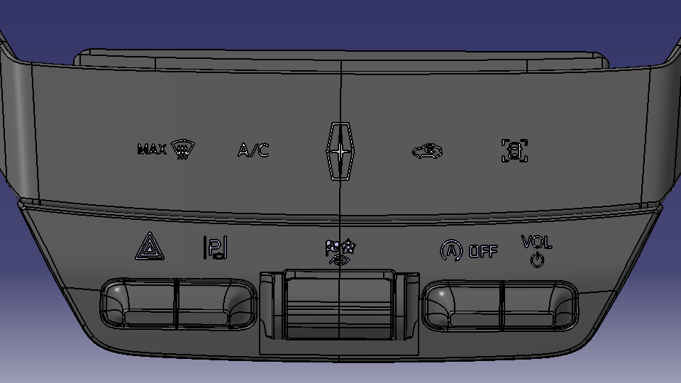
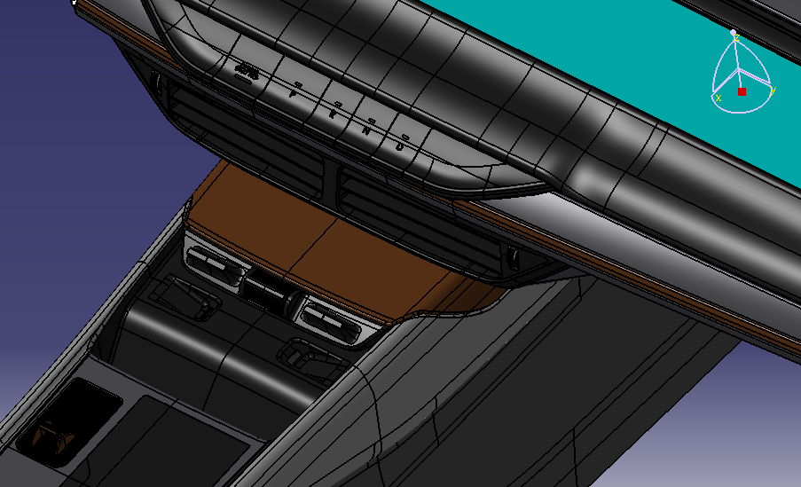

CD764 Mini ICP Design Requirement
CD764 FC4 Console Surface
FC4 Mini ICP
1
2
3
4
5
6
7
8
9
AUX
1). Mini ICP Hardwire connected for below Buttons.
#1 Max Defrost, Touch button to RCCM and w/ indicator from RCCM feedback.
#5 Hazard, Hard button to BCM and w/o indicator from BCM feedback.
#6 Parking Menu, Hard button to ADAS/PAAM and w/o indicator from ADAS/PAAM.
#8 Engine Start Stop, Hard button to RCCM and w/ indicator from RCCM feedback.
2). Mini ICP LIN to AUX for below buttons signal Transmit & Receive.
#2 A/C---Touch button for Control Compressor on/off, AUX transfer LIN to Private CAN signal to IVI, w/ indicator from IVI.
#3 Recirc--- Touch button for Control recirc/fresh air, AUX transfer LIN to Private CAN signal to IVI, w/ indicator from IVI.
#4 DAT Hot key---Hot key to IVI for TCS & Auto Hold , AUX transfer LIN to Private CAN send to IVI , w/o indicator from IVI.
#7 SDM---Hard Toggle button for SDM +/-, LIN transfer to Publish CAN signal to ABS, w/o indicator from ABS.
#9 VOL---Hard Toggle button for volume +/-, AUX transfer LIN to Private CAN send to IVI , be pressed for audio power on/off, w/o indicator.

Slide 2
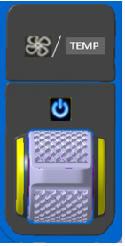
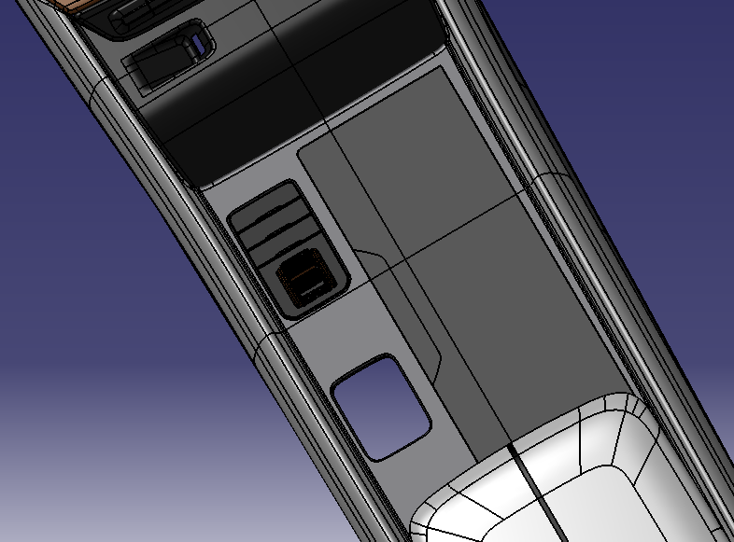


CD764 MFK Design Requirement
CD764 FC4 Console MFK Design Assumption
CD764 FC4 Console Surface
VOL
TEMP
AUX
1). MFK LIN to AUX , AUX transfer LIN to Private CAN signal to IVI, w/ indicator from IVI.
Below buttons signal Transmit & Receive.
Function:
Driver Temp +/- ；
Blower +/-;
HVAC on/off, w/ indicator feedback from IVI.
FC5 Proposal
Default Status
Driver Temp PoP out
1st time Pressed
Blower Speed PoP out
TEMP
TEMP
SYNC+ Screen
SYNC+ Screen
If continuous pressed toggle up/down, IVI sent several events to RCCM
HMI pop up Driver Temp +/- change rate as 10 steps per 1 second.
Example: If continuous pressed Temp + , HMI change from 23.5C to 28.5C in 1 second, 0.5C per step
If continuous pressed toggle up/down, IVI sent several events to RCCM
HMI pop up blower speed +/- change rate as 5 steps per 1 second.
Example: If continuous pressed Temp + , HMI change from 1 bar to 6 bar in 1 second

